Slide 1
Self Hovering Helicopter

Slide 2
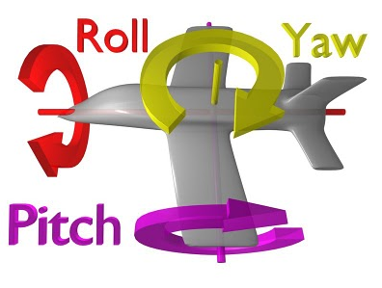
Objective
Maintain height of toy helicopter (in progress)
Control yaw and pitch (future)

Slide 3
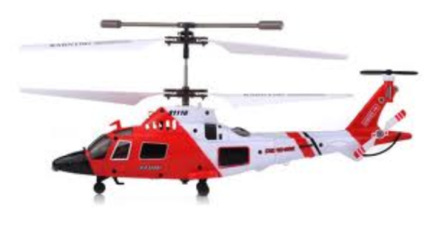
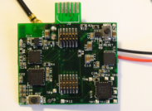
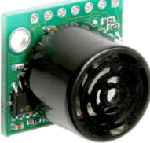

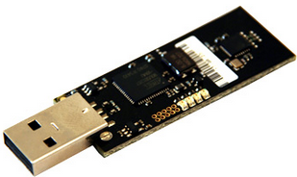
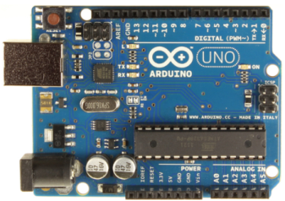
System Architecture
GINA
Sonar for height readings
Radio
Infrared

Slide 4
Strategy
Take in height readings from sonar
Process the data in the PC using a PID loop
Send output data to helicopter motors
Repeat

Slide 5
Sonar Characteristics
“Analog” output voltage of 2.9mV / cm
Not truly linear (sensitive to the inch)
Range: 15cm to 6.45m
Operates at 20Hz

Slide 7
Sonar readings

Slide 10
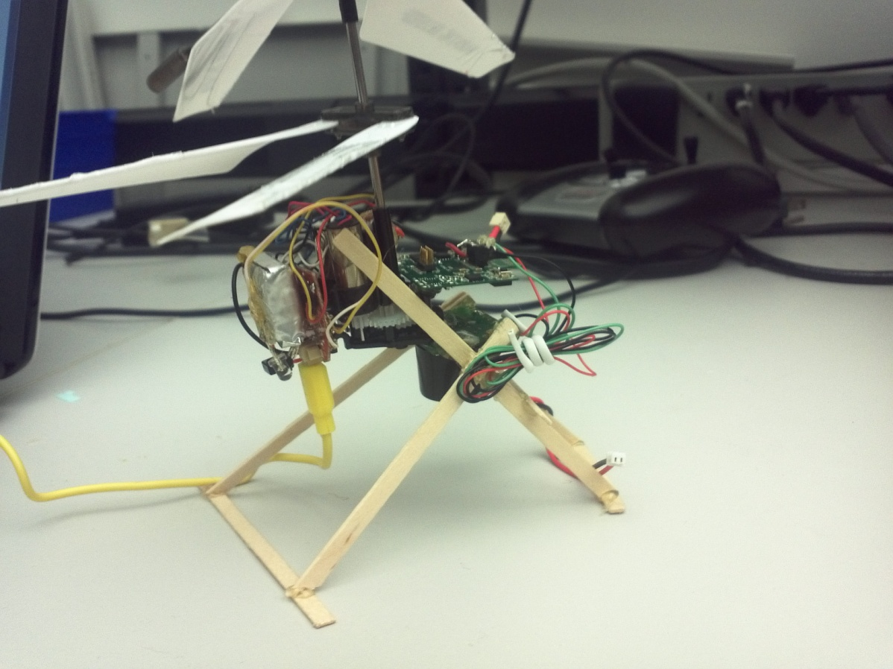
Problems
Noise in readings
Fragile hardware
Helicopter spin

